Slide 1
FARM DETECTOR

Slide 2
INTRODUCTION
we innovate one device is called farm Detector and we make app for the farmers. The device has chips, ai cameras , sensors and speakers that detects the soil moisture , soil temperature and soil fertility. It also detects how much water can plants required for its growth and it's detects weather too. And device has smart ai cameras that detects any fungus and any types of disease in the plants if any disease caught than device capture plant leaf photo and send message to farmers mobile phone to spray pesticides .

Slide 3
The device have cameras and sensors to watch who enters in farm in 24hr. If any one can enter in the farm device can send message to the farmers and starts ringing alarm.

Slide 4
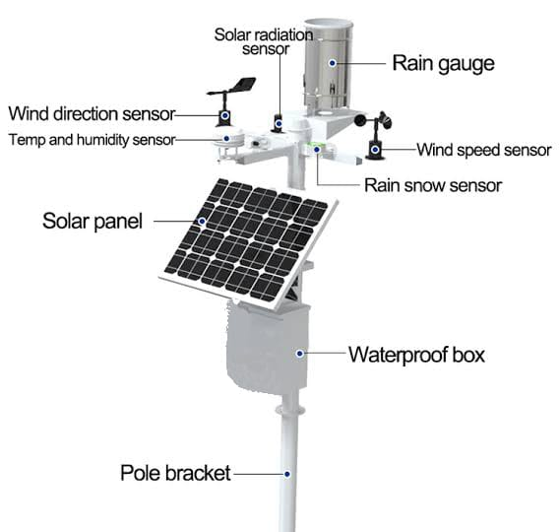
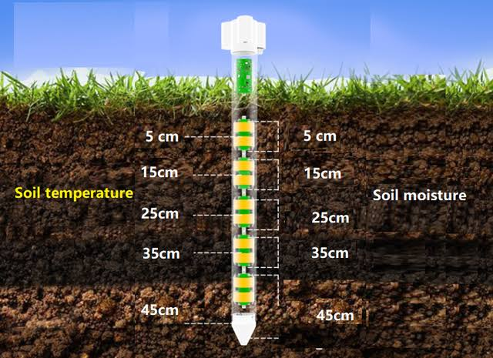

Slide 5
adventages
It decreases farmers manually work load
Increases growth of plants
It’s totally depended on solar panel therefore we can save electricity

Slide 6
DISADVENTAGES
Farmers want to on 24hr network to see full day updates
The device is very costly to purchase
In cloudy weather and without sun light the device will not work with accuracy because it’s totally depends on sunlight

Slide 7
जय जवान जय किसान

Slide 8
THANK YOU

